Slide 1

Machine Learning I: Final Project
Predicting whether current customers subscribe to a term deposit

Slide 2
Agenda
Business Problem
Data Modeling
Accuracy
Interpretation

Slide 3
BUSINESS PROBLEM

Slide 4
Whether or not current bank members would subscribe to a term deposit
Data:
Collected from
phone calls
between
employees
and customers
Problem being addressed
Term
Deposits:
fixed life investment strategies, withdrawn at maturity
Notes:
References:
http://www.investopedia.com/terms/t/termdeposit.asp?lgl=no-infinite
Bank-names.txt file

Slide 5
Why analysis is important
Marketing
Overall Goal
Create a model that accurately predicts term deposit subscription.
We can use this to market to a demographic that fits these predictors and who might not be aware of the existence of term deposits.
How to address future marketing plans and make them more successful
Determining most impactful variables allows tailoring of marketing strategies towards those demographics
This would increase term deposits
Safe Investment
Term Deposits are secured by the Government
By having more people sign up for term deposits, the bank can invest in more investment strategies which will increase profits

Slide 6
How we found our data
The Dataset
Used Google to find different Machine Learning Repositories
Found a dataset in the UC Irvine Machine Learning Repository.
Consists of 45,211 observations and 17 predictors
Background of the data
What the Bank’s goal was in analyzing this data
What was included
Initial Research

Slide 7
Cleaning & Structuring the data
Converted .txt file into .csv file
Grouped variables into more condensed groups to alleviate running time of program.
Most of the data was in the form of categorical data
We organized data that had many factors to decrease factor levels for better understanding of the data
Grouped dates into periods, 1= days 1:10, 2= days 11:20, 3= days 21:31
Grouped jobs into levels based on income- high, medium, low
Created factors for non-numerical predictors and then converted these factors into numerical values.
We converted it into numerical values in order to scale our categorical data

Slide 8
DATA MODELING

Slide 9
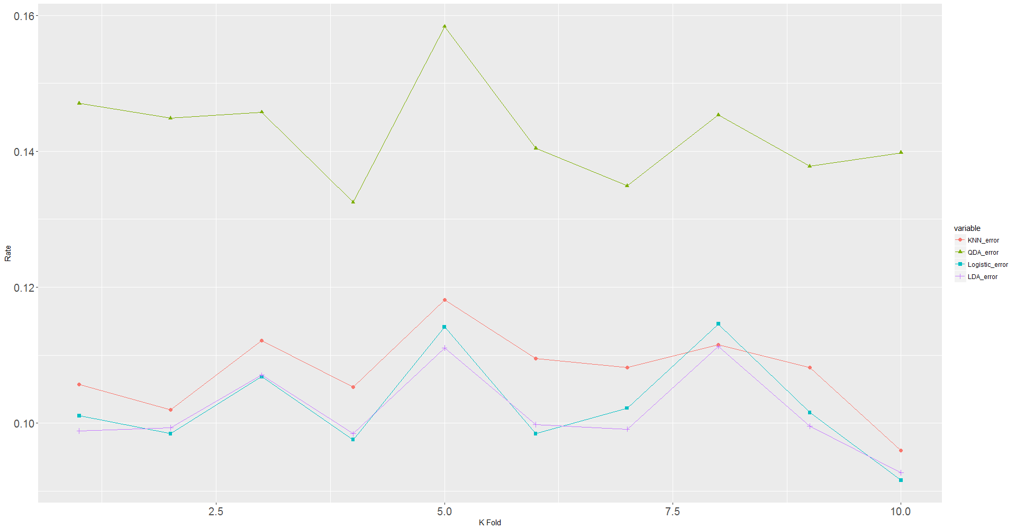
Modeling Steps
We randomly shuffled the data and then performed 10 cross-validations for our four models (KNN, Logistic Regression, LDA, and QDA)
Error rates are very similar (between 0.1 and 0.15)
across all 4 models.
We used a k-fold of 6 to partition our data for all of our models to test model accuracy

Slide 11
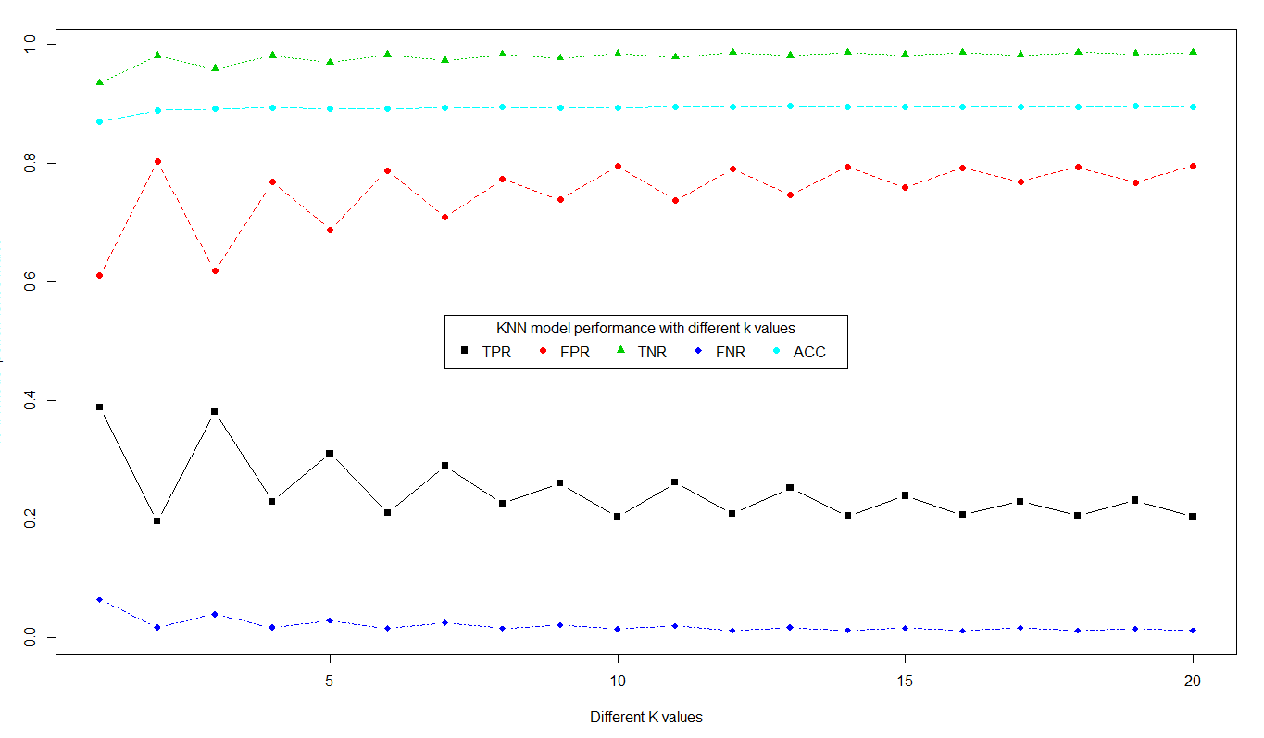
Modeling Steps
2. Next, we selected the best k value for our business setting. We tested different K values for our test set from k=1 to k=20, found k=3 to have a high TPR, low FPR and a high accuracy rate.
A high TPR means that we correctly identified customers who will subscribe to a term deposit and thus is highly correlated with the profits from our marketing campaign

Slide 13
Modeling Steps
4. Next, we tested different probabilities from .05 to .95 and found 0.1 to be the best combination of accuracy and TPR

Slide 14
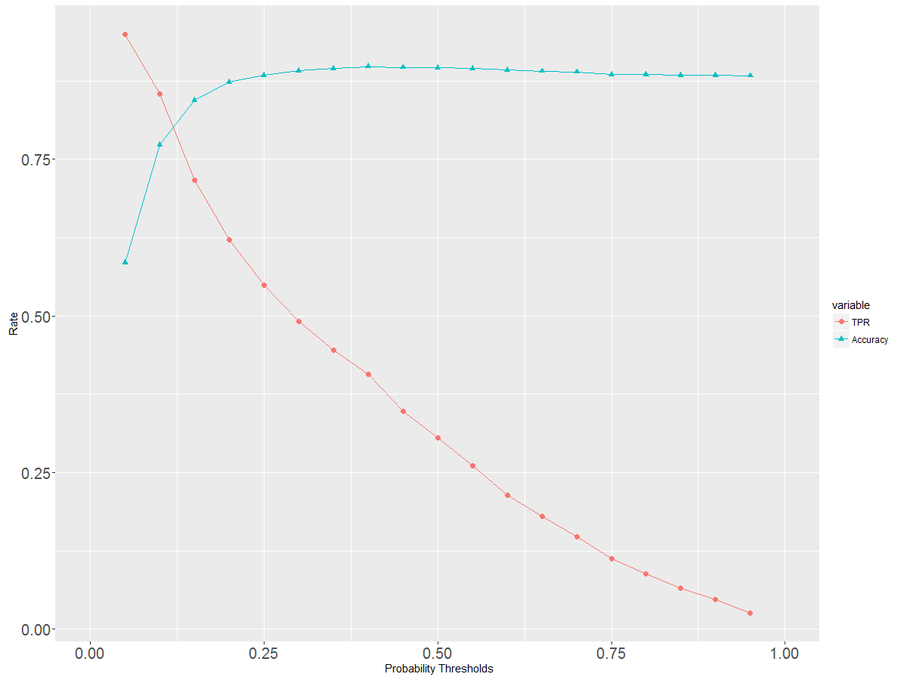

Slide 15
Fighting Overtraining
Overtraining was avoided via :
● Large data set of more than 40k observations reduces variance;
● Conducting 10 times cross-validation for each models, all models have similar error rate(range from 0.10~0.15);
● In each model, we test the model using the training and test date set, both have similar error rate.

Slide 16
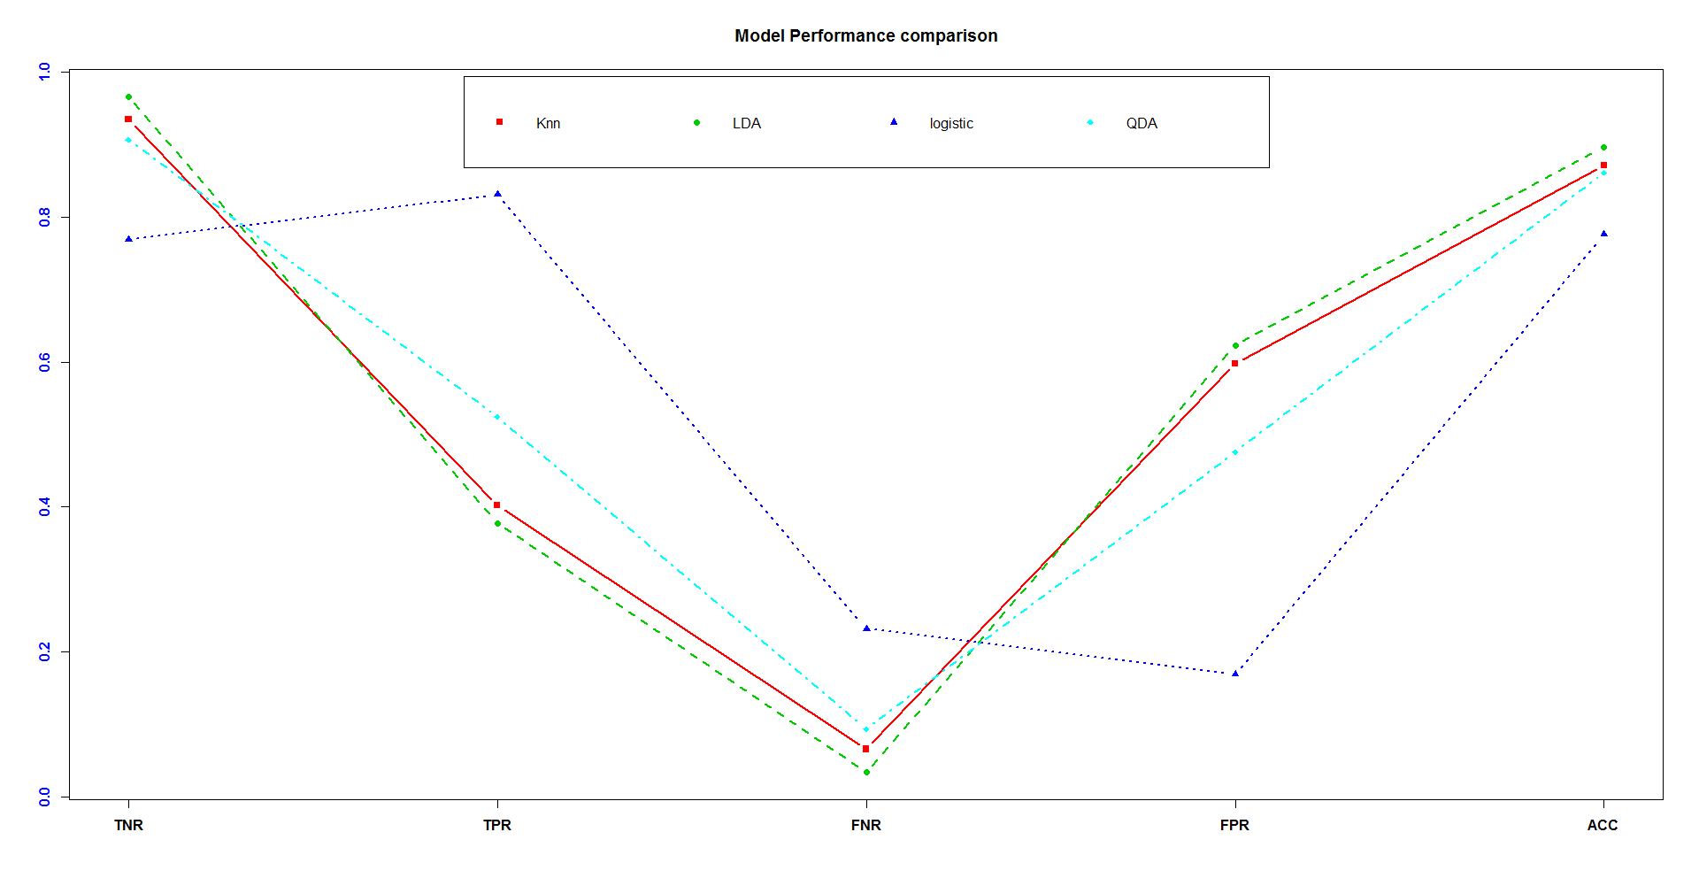
It’s a tough choice!
Rate
Model comparison using multiple indexes(rates)
Each model has different performance in each index

Slide 17
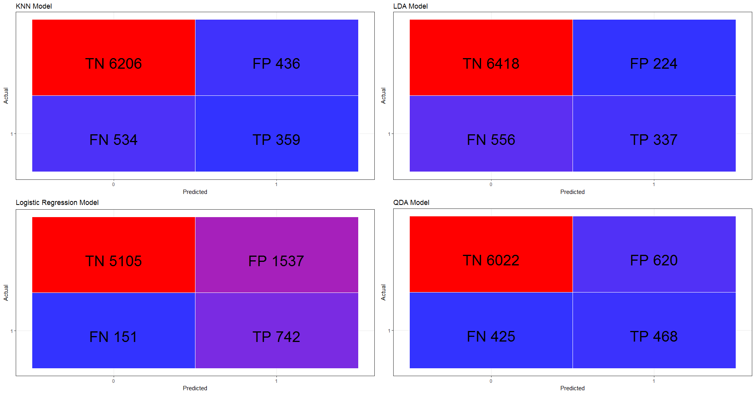

Model Selection for Business
Profits = Revenue - Expense = TP * b - (FP + TN) * a

Slide 18
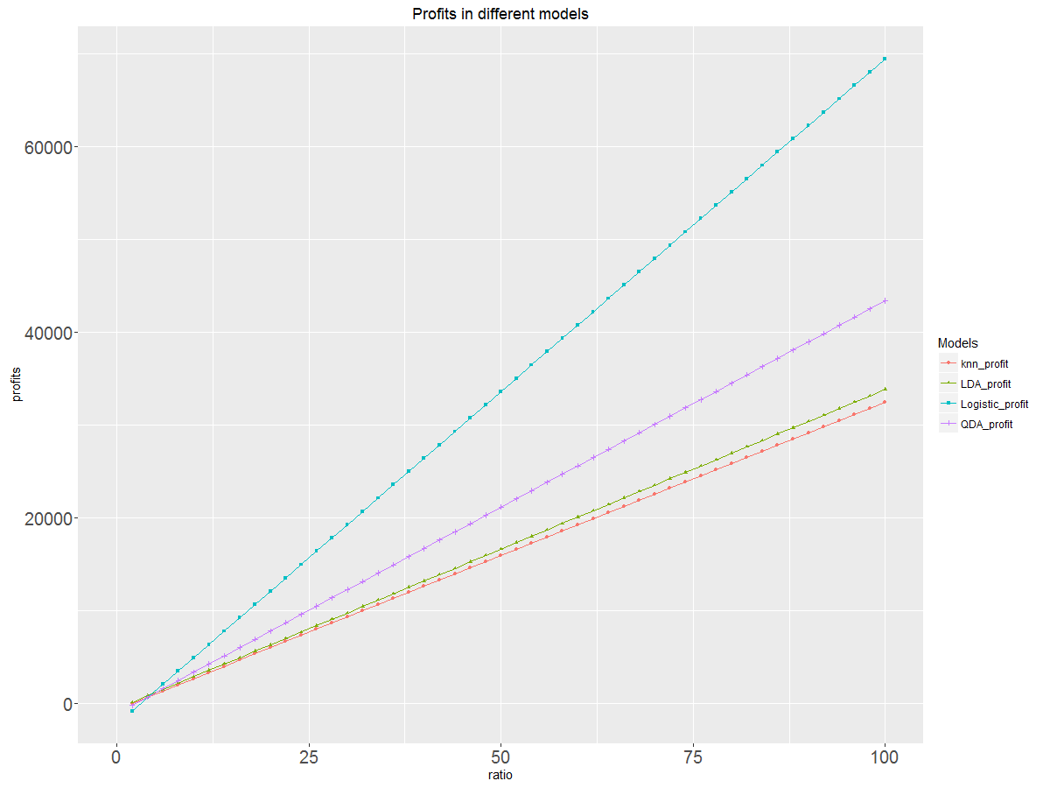
Higher profits, better model
a = cost for marketing
b = revenue per successful customer
R = b/a
Profits = TP * R - (FP+FN)
When R is low, logistic regression performs badly but as R increases logistic regression outperforms the other models
If the revenue units is divided by advertisement cost per customer then the selection of the model will be left up to the bank as they are all similar at the low profit level.

Slide 19
INTERPRETATION

Slide 20
Interpretation of Results
With the business scenario facing the Portuguese Bank, we would recommend the selection of the Logistic Regression Model because it produced the largest True Positive Rate (83.1%), which would ultimately leads to the most profit.
Similarly, the logistic regression has the lowest False Negative Rate (FNR) which only adds to to it’s validity as the best model. This is especially true in this particular context because a FNR means that we assume that a customer will opt for a term deposit but they do not actually sign up. This is damaging for the bank’s business forecasts.
A False Positive Rate (FPR) assumes unexpected customers in the model’s prediction end up signing up for a term deposit. This is not as much of a concern as the FNR as they don’t affect the business forecasts negatively.
Conclusion: By using the Logistic Regression model, we can effectively target customers who are not aware of the term deposits and are likely to open an account

